Slide 1
Employee Data Analysis using Excel
STUDENT NAME: RADHAKRISHNAN JAYAKUMAR
REGISTER NO: 3122O6780
NM ID: 6B3653151B948259D704DC9CAA5E112D
DEPARTMENT: B.COM (ACCOUNTING & FINANCE)
COLLEGE: AGURCHAND MANMULL JAIN COLLEGE

Slide 2
PROJECT TITLE
Employee Salary Analysis using Excel

Slide 3


AGENDA
Problem Statement
Project Overview
End Users
Our Solution and Proposition
Dataset Description
Modelling Approach
Results and Discussion
Conclusion
3/21/2024 Annual Review

Slide 4

PROBLEM STATEMENT
In all the organisations, analyzing the salary paid is a very crucial problem. An organization must ensure that its employees are paid appropriately as per the work they perform and are not underpaid.

Slide 5

PROJECT OVERVIEW
This project focuses on studying about the salary paid to employees of different departments and at different locations.
The project is focused on analyzing about the salary by categorizing it into 3 Levels for a simpler and better understanding.

Slide 6

WHO ARE THE END USERS?
HR Managers
Finance Department
Employees
Senior Management

Slide 7

OUR SOLUTION AND ITS VALUE PROPOSITION
Filters : Sort and view specific data subsets, like salaries by department.
Formulas: Perform calculations such as SUM, AVERAGE, and MEDIAN for salary analysis.
Pivot Tables: Create dynamic summaries and views of salary data, such as average by job title.
Charts and Graphs : Visualize trends and distributions with bar charts, pie charts, and histograms
Conditional Formatting: Highlight key data points, such as salaries exceeding a set threshold
Data Validation : Ensure accuracy by setting rules for data entry, like numerical limits.
Data Cleaning Tools : Prepare data by removing duplicates and splitting text into columns.
Advanced Filters : Extract data based on complex criteria for detailed analysis

Slide 8
Dataset Description
Employee ID : Unique identifier for each employee.
Name : Name of the Employee.
Job Title : The position or role held by the employee.
Department : The department or division where the employee works.
Base Salary : The annual base salary amount.
Bonus : Additional compensation.
Total Compensation : Sum of base salary and bonus.
Years of Service : Duration of employment with the organization.
Location : Office or branch location where the employee is based.

Slide 9

THE "WOW" IN OUR SOLUTION
Salary Buckets Formula:
=IF(E2<50000,"Level 1",IF(E2<100000,"Level 2",IF(E2<150000,"Level 3")))
3/21/2024 Annual Review
9

Slide 10
MODELLING
DATA COLLECTION :
- From ‘Kaggle’
DATA CLEANING:
- identified missing values
- filtered out missing values
PIVOT TABLES :
- Summarize and aggregate salary data, such as average salary by departments
CHARTS AND GRAPHS :
- Visualize trends and comparisons, including line graphs for salary changes over time and bar charts for departmental comparisons.
10

Slide 11
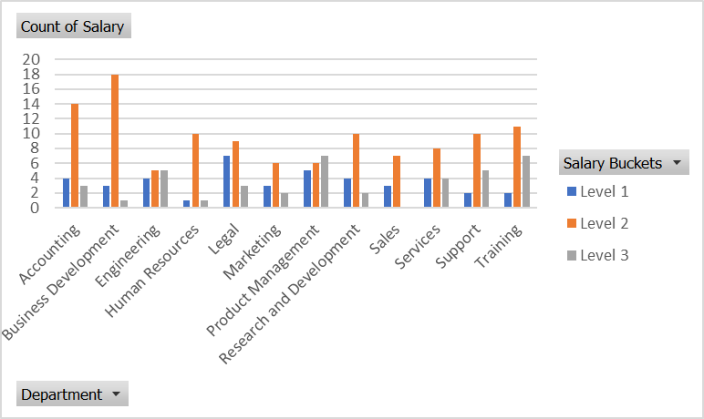
RESULTS
11

Slide 12
conclusion
By analyzing the salary of employees through excel, we can easily group the employees on the basis of a certain group of salary and can even present this data in a good manner by using pivot table.
The findings highlight areas where salary adjustments may be necessary to promote fairness and enhance the satisfaction of employees.
This analysis helps in decision making in an organization and to ensure that the right employees are paid as per their work and the salary that they deserve.

